Slide 1
GS1 Digital Transformation Awards 2025
Submission for
Excellence in Operational Impact
Company: HGC Global Communications
Contact Name: Anita Chan
eMail: anita.chan@hgc.com.hk
Tel: 3529 5561
Notes:
1

Slide 2
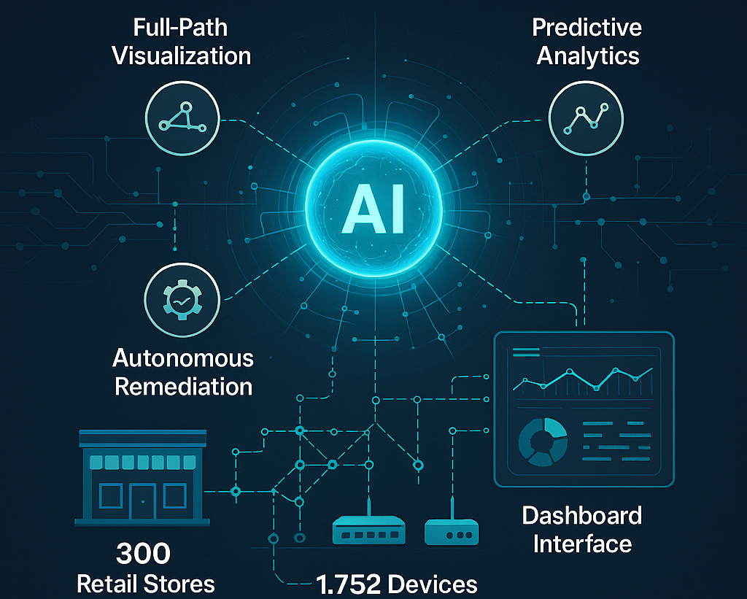
GodEye Intelligence Platform - Build different, Run different
Notes:
2 3

Slide 3
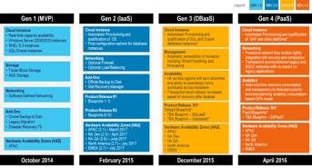
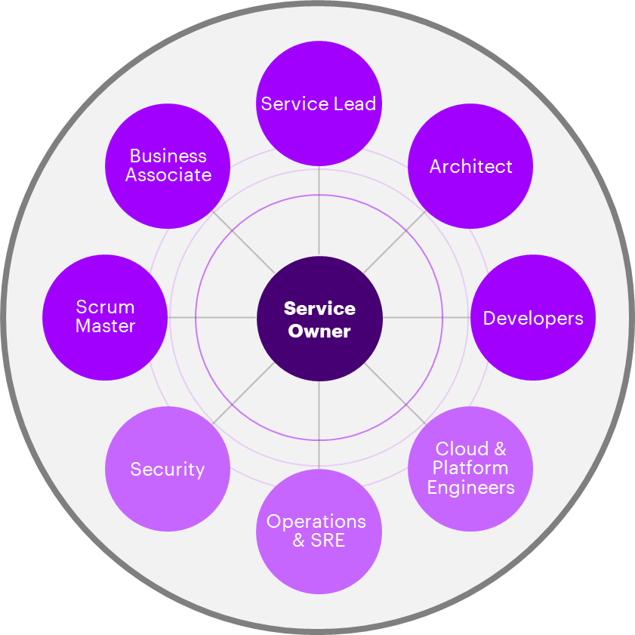
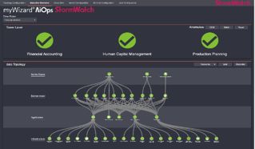
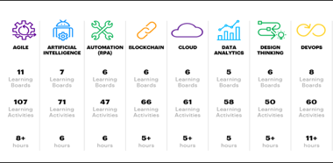
Innovation & Technologies
Project Goals & Objectives - Build Different / Run Different
Key Things to Get Right
UNIFIED GOVERNANCE & PROGRAM MANAGEMENT
ACROSS APPLICATIONS AND INFRASTRUCTURE
Standardization
& Service Catalog
Agile Operating Model
Hyper-Automation Powered By AIOPS
Upskill Organization & Transform Culture
SECURE AT THE CORE
Notes:
4 Project Goals & Objectives

Slide 4






Innovation & Technologies
Planning & Strategy: Our Service Philosophy
Boundaryless
Adaptable
Radically Human
Governance & Architecture
Standardization
Agile/Cloud Operating Model
Hyper-Automation & AIOPs
Talent & Culture
Business Outcomes
Work Different
Work Different
Migrate Different
Build Different
Run Different
Application & Data Modernization
Optimization by Design
Cloud, Infrastructure & Security Enablement
Analytics
Automation
AI
Innovation
KEY TECHNOLOGIES
Notes:
5

Slide 5


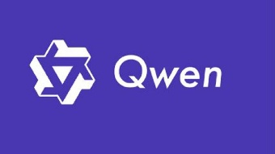

Innovation & Technologies
Technologies / Solutions Adopted: AI-Enabled Meraki LLM agent
Godeye Platform
Notes:
6

Slide 6

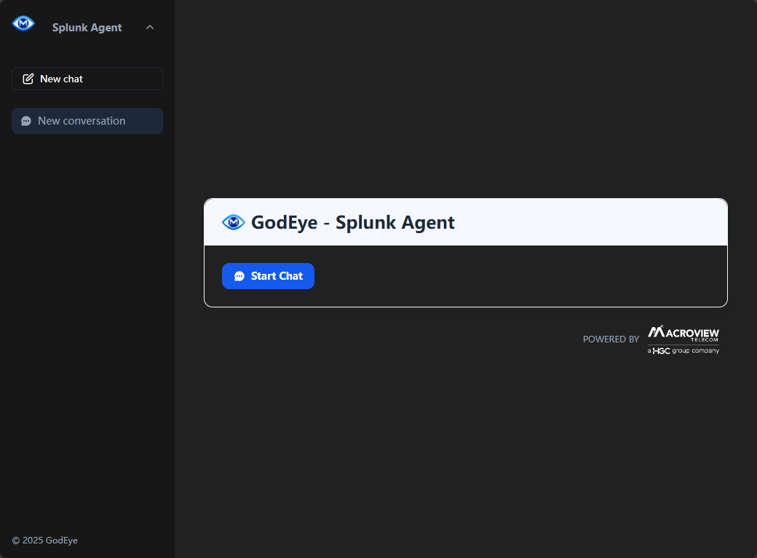





Innovation & Technologies
Technologies / Solutions Adopted: Overall Solution Architecture
LLMOps Assistant
LLM – Local Mode / On-Cloud Mode
HGC
High-Performance Backbone
Godeye
Platform
Qwen
DNA
Meraki
Store
Network
Secure
Network
Notes:
6

Slide 7



Innovation & Technologies
Technologies / Solutions Adopted: Agent Data Flow
AI Assistant retrieves network performance data or performs specific tasks
User
Meraki Agent
DeepSeek Qwen
Prompt
Prompt and Function declaration
Function identifier and parameters
Request
Function Calling
MIDAS Platform
API
Response
Response from API
Response
Response
Notes:
6

Slide 8














Innovation & Technologies
Technologies / Solutions Adopted: Solution Architecture
Devices & Services
GodEye Intelligence Platform
Public LLMs
Collecting & Analysis
AI Assistant
Cloud
Backend
Database
Vector
Database
API
Processing
Server
AI Assistant
Server
Private LLMs
Controllers
GW
Ollama
API
API/MCP
Server
Front-End
Web
AI Assistant
Web
LocalAI
Campus Network
Computing & Storage
User
Notes:
6

Slide 9
Business Model and Use Cases
Global Fast-Food Chain Use Case
Background
A leading global fast-food chain operating over 270 stores in Hong Kong sought to streamline its retail IT operations. The use of multiple vendors had introduced complexity, slowed incident resolution, and impacted both operational efficiency and customer experience.
Scope
The transformation initiative centralized the management of 1,752 infrastructure devices — including routers, switches, and access points — across over 270 store office networks, under a unified and proactive managed service framework.
Our Solution: Godeye Intelligence Platform
HGC Macroview deployed GodEye, an AI-powered intelligent perception platform designed to redefine network operations and ensure seamless connectivity across all sites. Key capabilities include:
End-to-end network visualization for real-time monitoring across all nodes
Self-learning AI that builds a dynamic knowledge base
Predictive analytics to proactively identify and mitigate risks before any service impact
Autonomous remediation to minimizes downtime by reducing MTTD and MTTR
Godeye Intelligence Platform
By consolidating service delivery and leveraging AI, Godeye significantly enhances operational efficiency, enabling a smarter, more resilient digital infrastructure.
With this transformation, the customer has achieved a resilient, future-ready network environment that supports operational excellence and delivers a consistent, high-quality customer experience across its retail footprint.
Notes:
2 3

Slide 10





Implementation & Adoption
Implementation Approach: Framework and Workstream
Users
B2B Self-Service
HGC Enterprise AI Platform
Job Dispatch
Automation
Ticketing System
ITIL Compliance
GodEye
Mission Commands
Request Review & Approval
“Common” Knowledge and wisdom
Injecting Enterprise KB and Proactive Monitoring Service
Log & Status
Operators
OmniView
Infrastructure
Notes:
7

Slide 11



Implementation & Adoption
Implementation Approach: Strategic Rollout
Foundation
Market Validation
Scale & Growth
Q3 2025 – Private Beta Launch: Building the Foundation
Q4 2026 global expansion
Joint organizational structure with dedicated teams
Comprehensive go-to-market
Customer Success Programs

Slide 12

Implementation & Adoption
How Challenges Were Overcome
CHALLENGES
SOLUTIONS
AI model reliability in critical network environments
Multi-agent coordination complexity and state management
High infrastructure compute costs impacting pricing
Difficulty demonstrating clear customer ROI
AI model security against adversarial attacks
Complex regulatory compliance (HIPAA, SOX, PCI-DSS)
Enterprise skills gap in AI network management
Cultural resistance to AI automation
Slow enterprise adoption due to risk aversion
Technology standardization risks
Rigorous testing, human-in-the-loop checks, confidence scoring, and rollback safeguards.
Smart orchestration, distributed consensus, and agent prioritization.
Optimized models, edge deployment, and flexible usage-based pricing.
Impact dashboards, case studies, and pilot success guarantees.
Input validation, hardened models, red team testing, and AI safety protocols.
Built-in compliance, regular audits, and industry-specific templates.
Training programs, managed services, and phased automation rollout.
Augmentation messaging, retraining support, and productivity-focused adoption.
Proof-of-concept pilots, thought leadership, and gradual deployment paths.
Open-source tools, standards alignment, and modular architecture.
Notes:
8 9

Slide 13
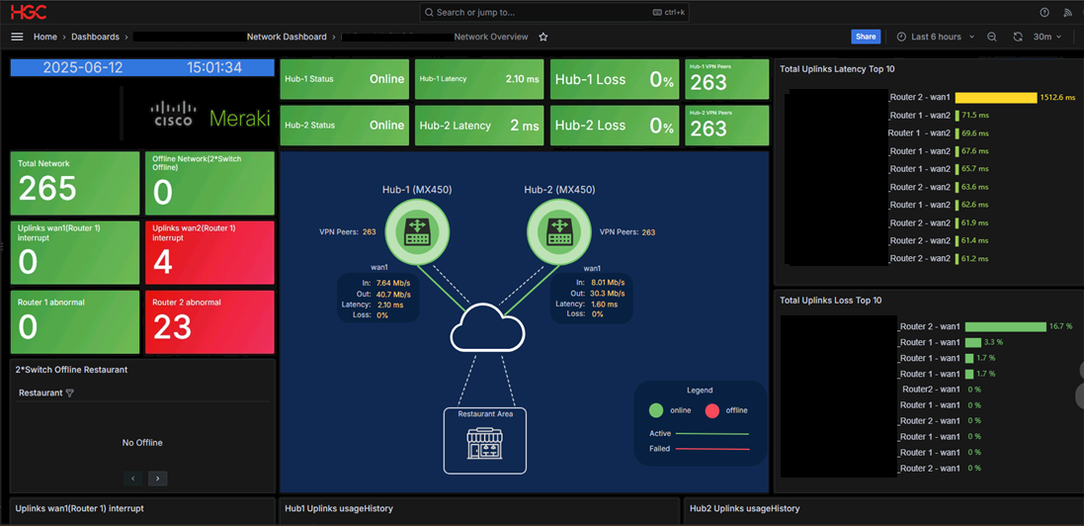
Measurable Benefits & Impacts
Operational Excellence Achievements: Traditional Dashboard
Notes:
11

Slide 14
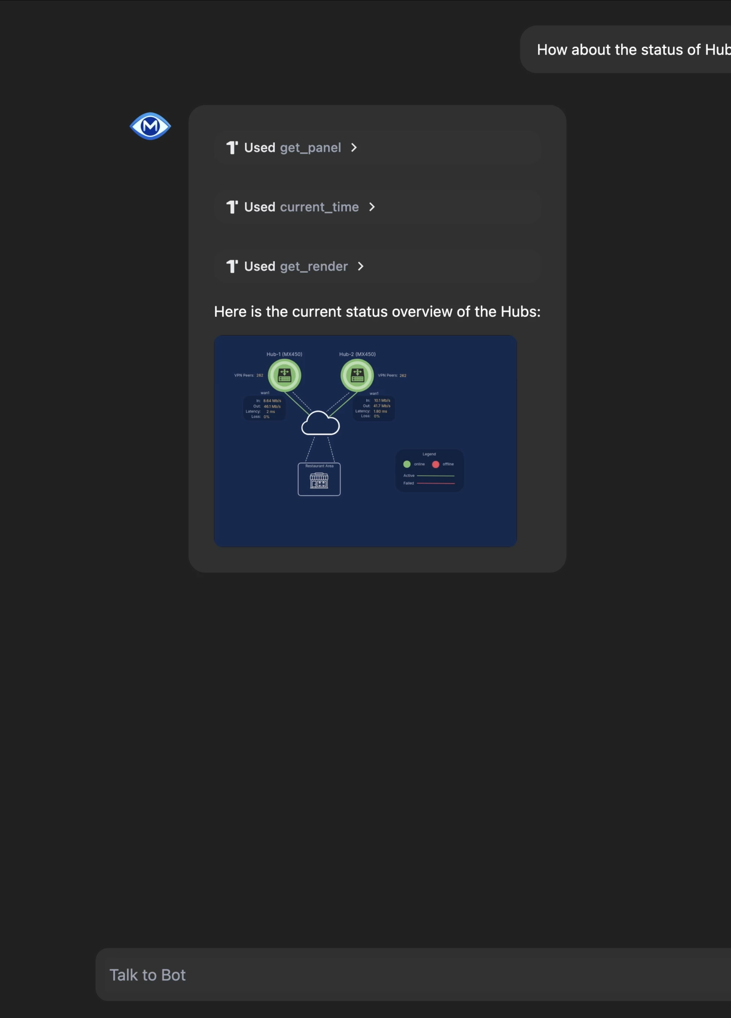
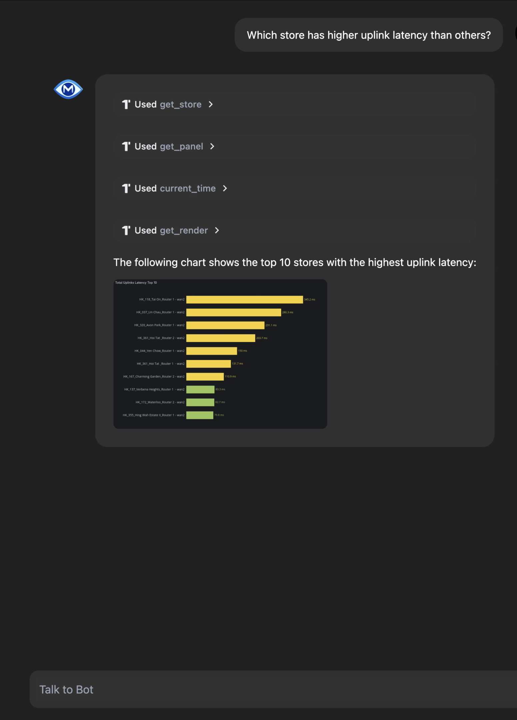
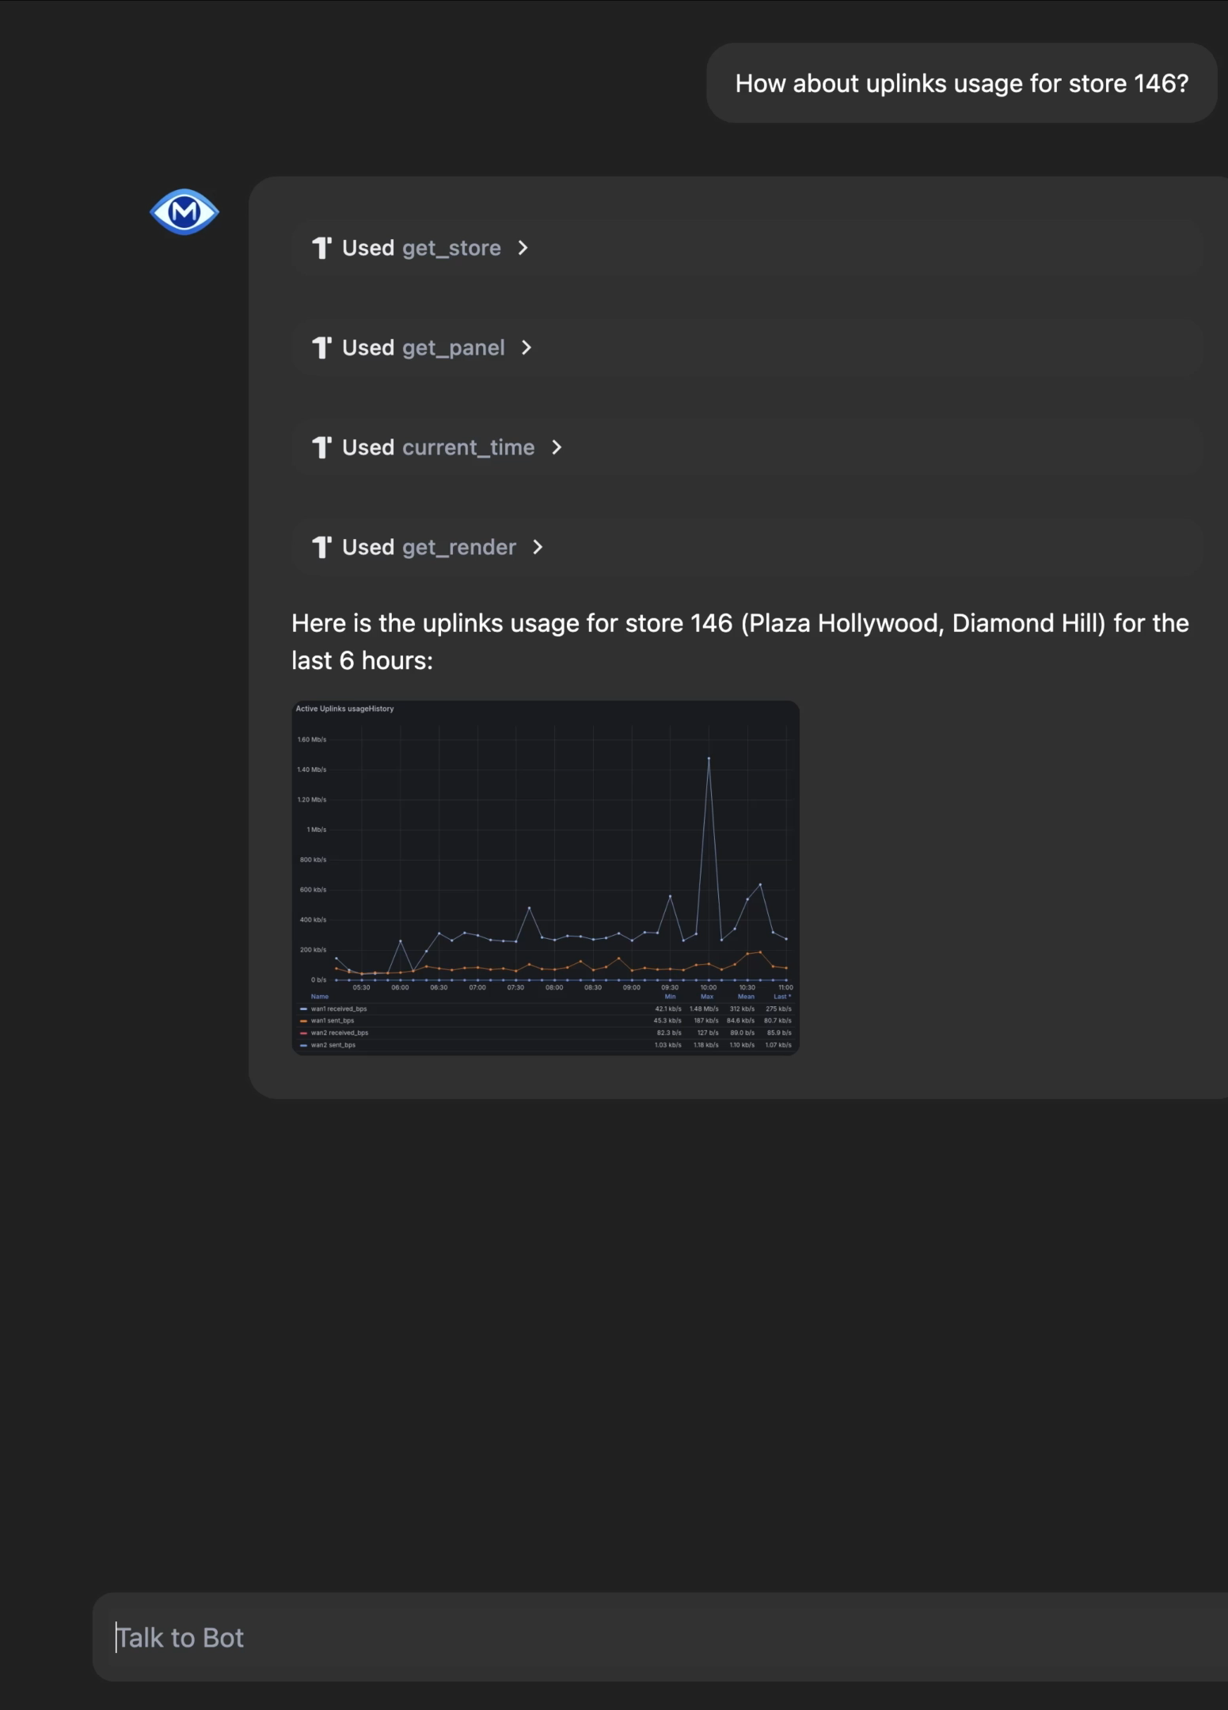

Operational Excellence Achievements:
LLMOps with GodEye Intelligence Platform
Measurable Benefits & Impacts
Operational: 75% reduction in troubleshooting time, 60% decrease in MTTR
Strategic: Enhanced customer experience, accelerated digital transformation
Cisco GBA AI Breakthrough Lighthouse Award (Jul 25)
Notes:
10 11

Slide 15





Scalability & Business Sustainability
Innovation & Technology Highlights: The Evolution of Operations
Natural language interaction
Automated task execution
Command Line, high learning curve
Intelligent fault diagnosis
GodEye
Platform
Takes time to search for documentation
Predictive maintenance
Human error and repetitive work
Transform Operation
Knowledge management and transfer
Legacy NetOps
CLI & GUI
Operation with LLM
Employee turnover leads to knowledge loss
Notes:
12

Slide 16

Scalability & Business Sustainability
Future Plan
Technology roadmap: Generative network configuration, edge intelligence, digital twin
Market expansion: Vertical solutions, SMB market, international growth
Innovation pipelines: Multimodal AI, quantum-ready security, sustainability optimization
2030 vision: Autonomous Network Operating System managing 90% of operations

Slide 17


you!
Thank

